Slide 1
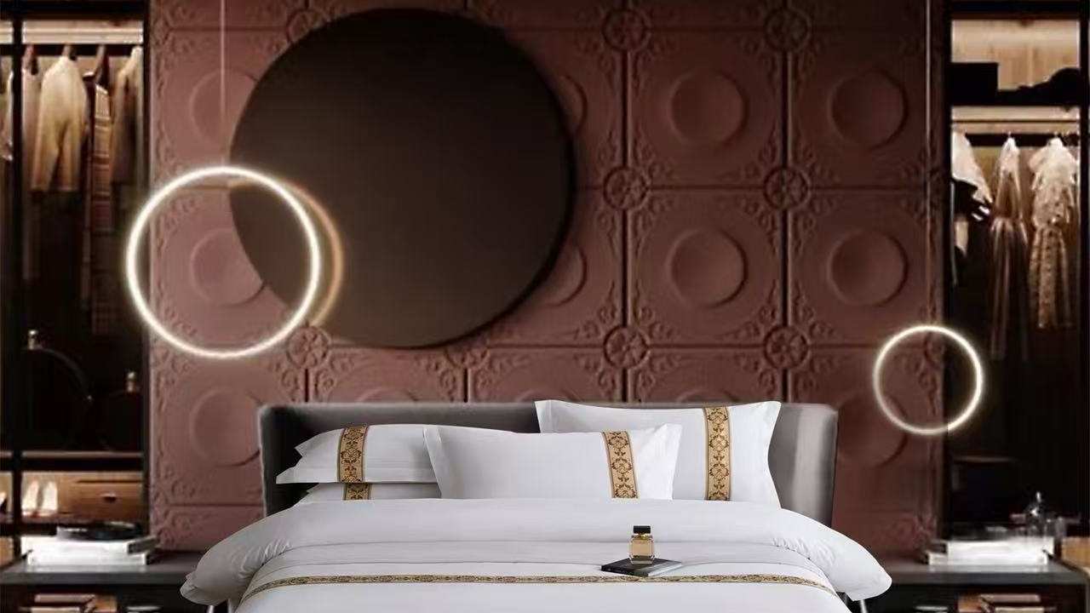
HOTEL LINEN
COLLECTION
Guest room essentials with custom sizing and specifications
BEDDING | TOWELS | PROTECTORS | INSERTS
2026

Slide 2
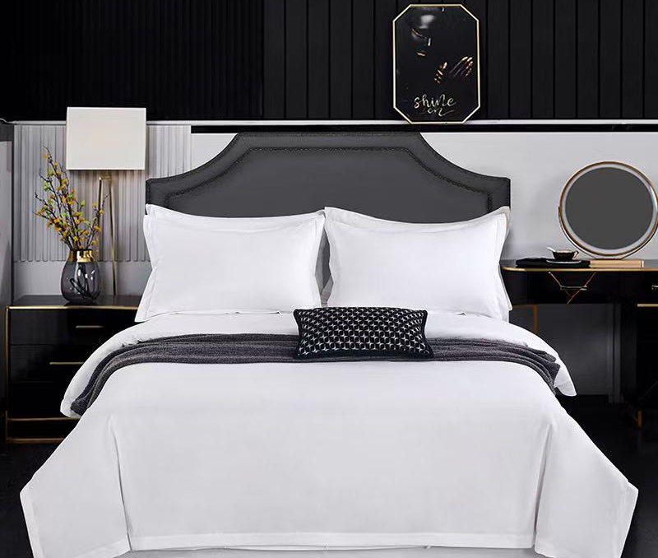
COLLECTION OVERVIEW
A flexible collection for hotel guest rooms
Products in this catalog
01
Decorative bedding sets
White hotel bedding with embroidery, woven tape, piping or minimalist finishes.
02
Bed runners and cushions
Coordinated decorative pieces for standard hotel bed widths.
03
Bath towels
A white 100% cotton towel series in four common hotel sizes.
04
Protectors and inserts
Mattress protectors, stain protection pads and quilt inserts.
CUSTOM HOTEL LINEN
02

Slide 3
MADE TO ORDER
Customization for each hotel project
Every style can be adjusted to the room standard and brand brief.
SIZE
SPECIFICATION
Custom dimensions for duvet covers, sheets, fitted sheets, pillowcases, runners and protectors.
Set configuration, fabric construction, finishing details and product format can be confirmed per order.
WEIGHT
BRANDING
GSM or filling weight can be adjusted to the intended hotel application.
Embroidery and logo customization are available for applicable products.
The catalog lists reference sizes from the supplied hot-selling range. Final specifications should be confirmed before production.
CUSTOM HOTEL LINEN
03

Slide 4
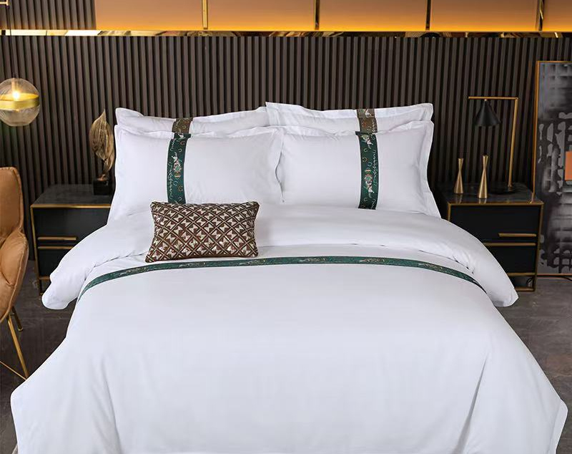
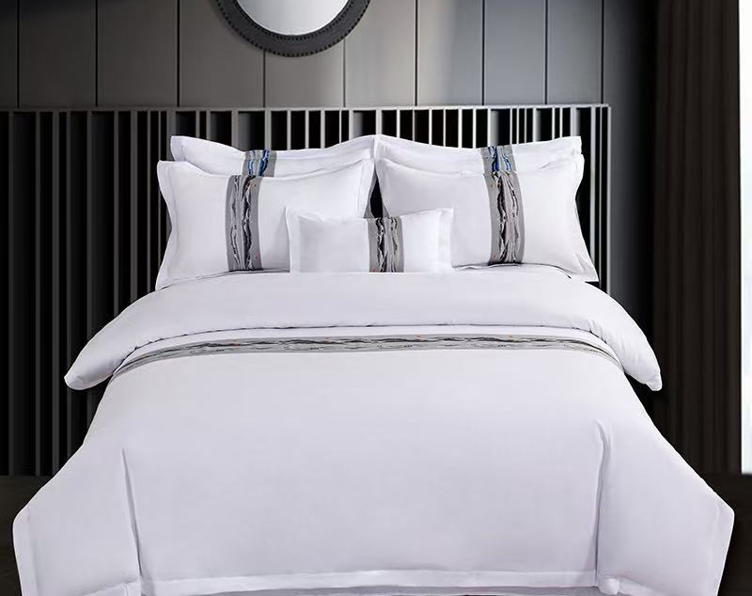
BEDDING COLLECTION
Decorative bedding styles 01-02
BL-01
Emerald ornamental tape
BL-02
Marble-effect decorative band
White base. Trim and set configuration can be customized.
White base. Trim and set configuration can be customized.
CUSTOM HOTEL LINEN
04

Slide 5
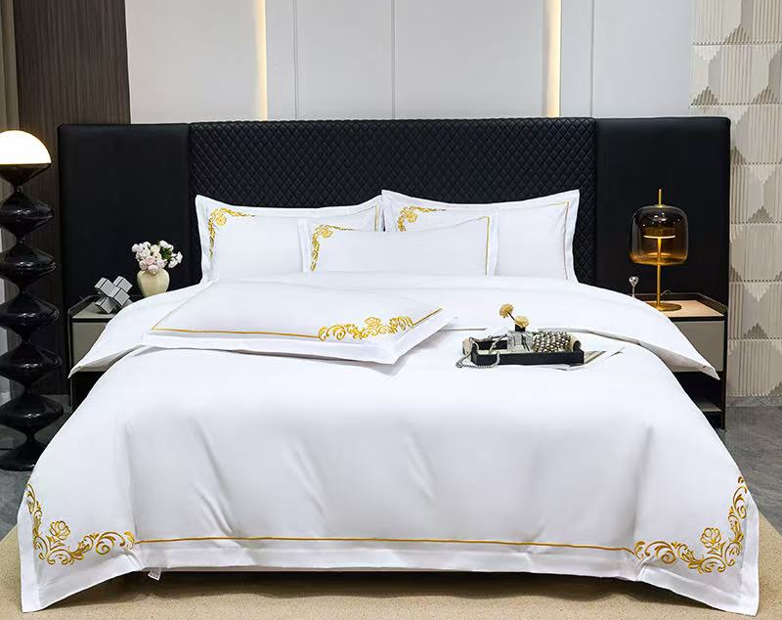
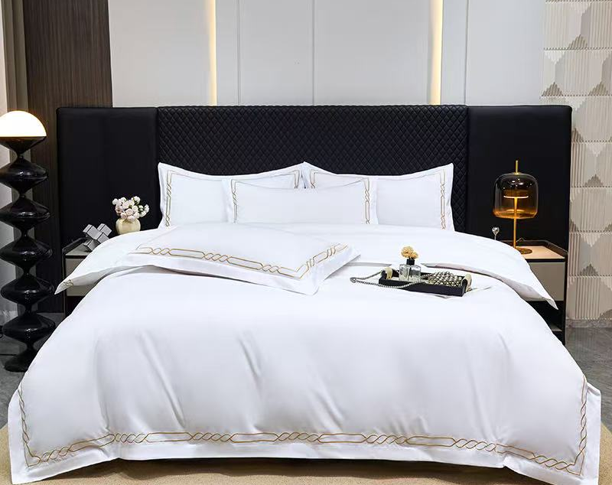
BEDDING COLLECTION
Decorative bedding styles 03-04
BL-03
Gold corner embroidery
BL-04
Gold chain embroidery
White base. Trim and set configuration can be customized.
White base. Trim and set configuration can be customized.
CUSTOM HOTEL LINEN
05

Slide 6
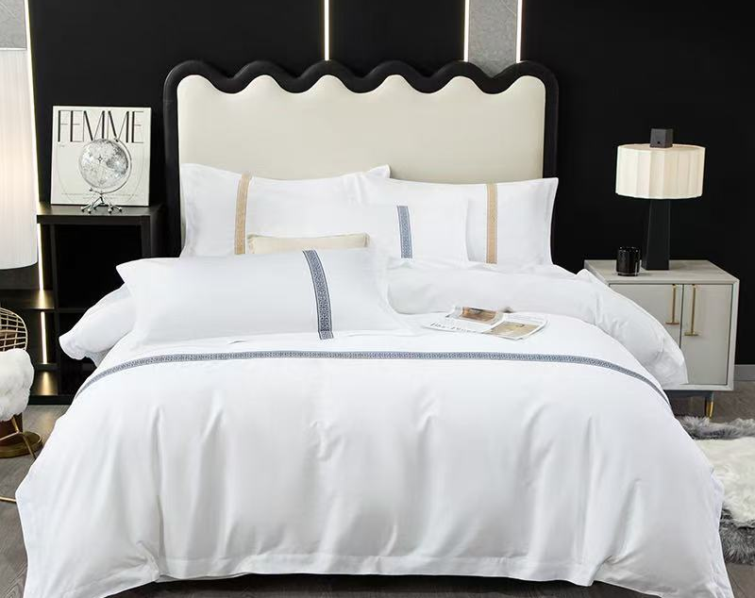
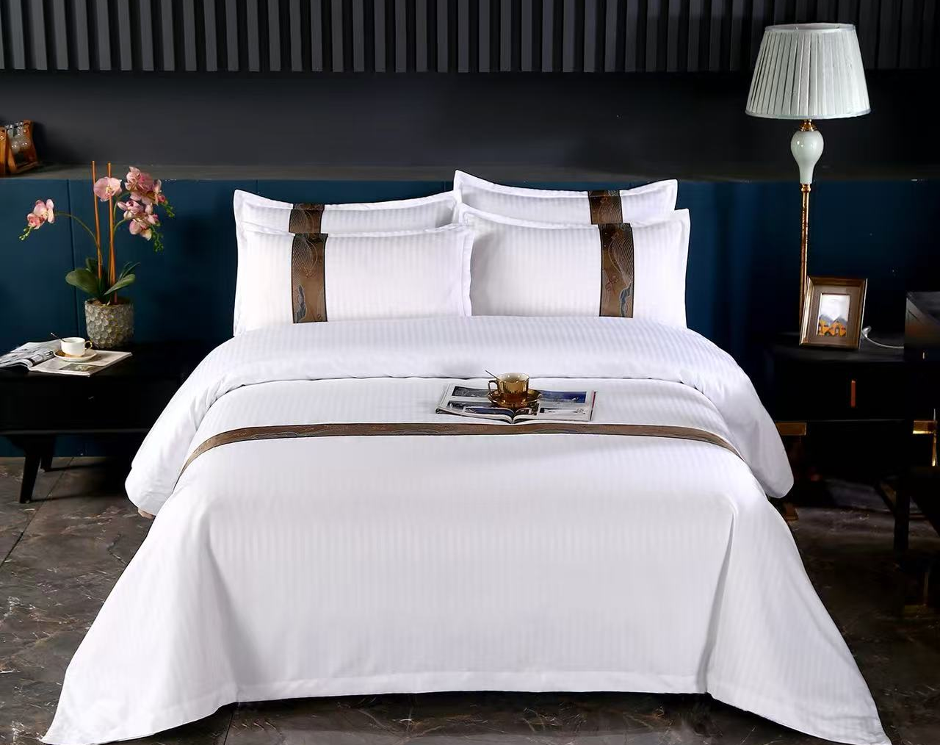
BEDDING COLLECTION
Decorative bedding styles 05-06
BL-05
Twin accent trim
BL-06
Bronze woven trim
White base. Trim and set configuration can be customized.
White base. Trim and set configuration can be customized.
CUSTOM HOTEL LINEN
06

Slide 7
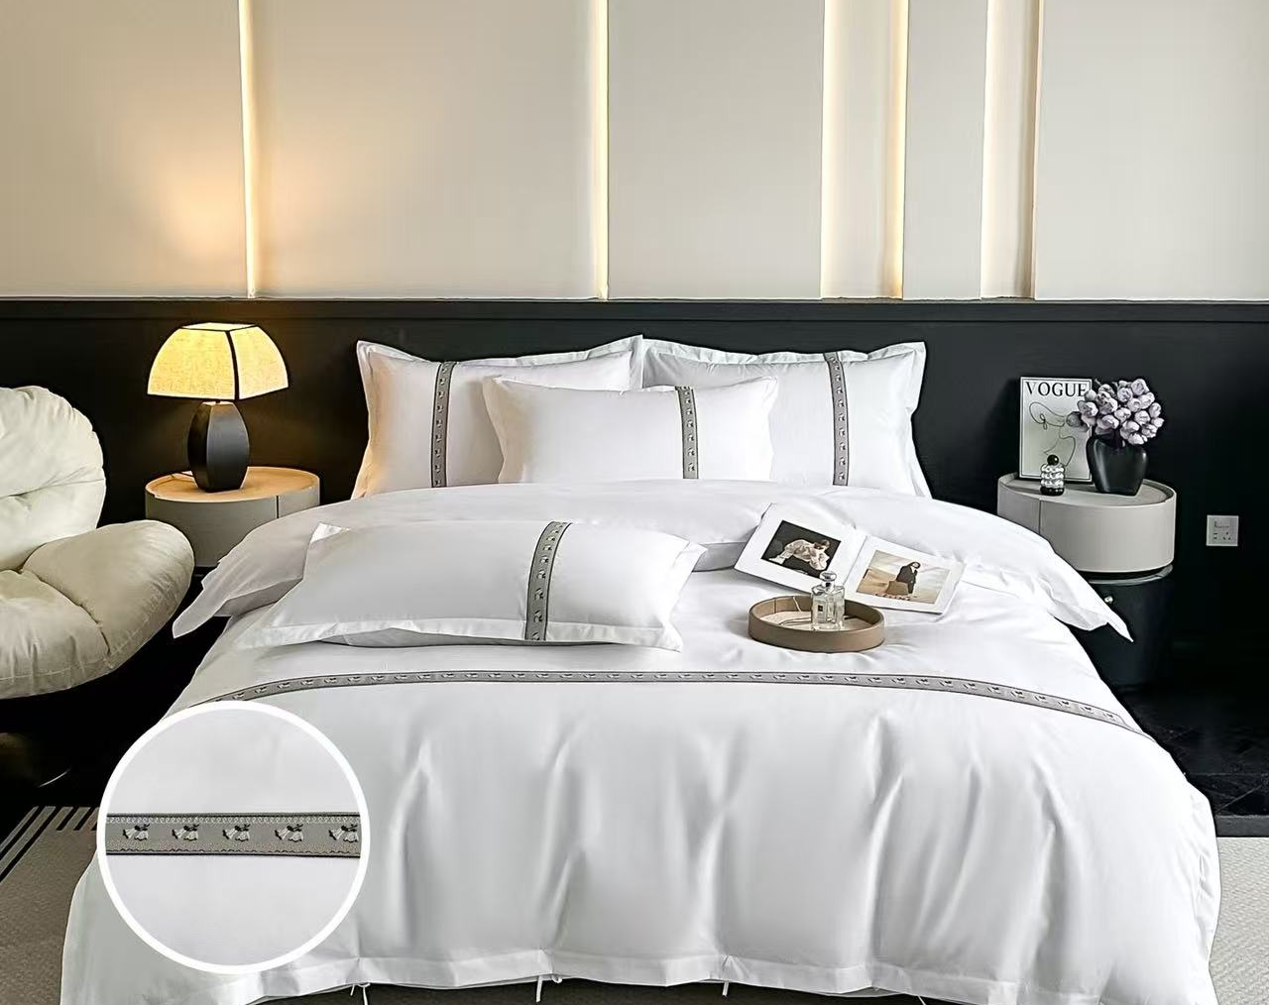
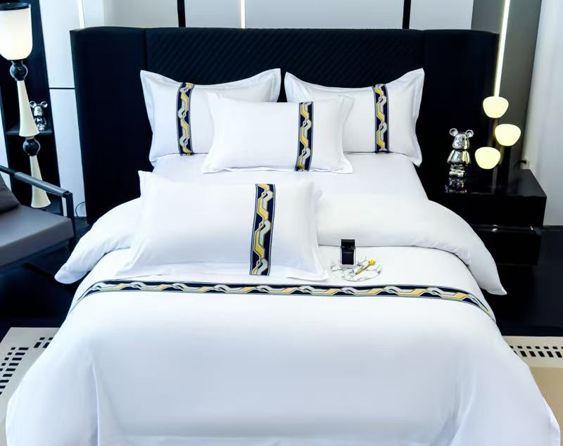
BEDDING COLLECTION
Decorative bedding styles 07-08
BL-07
Silver motif trim
BL-08
Navy and gold geometric trim
White base. Trim and set configuration can be customized.
White base. Trim and set configuration can be customized.
CUSTOM HOTEL LINEN
07

Slide 8
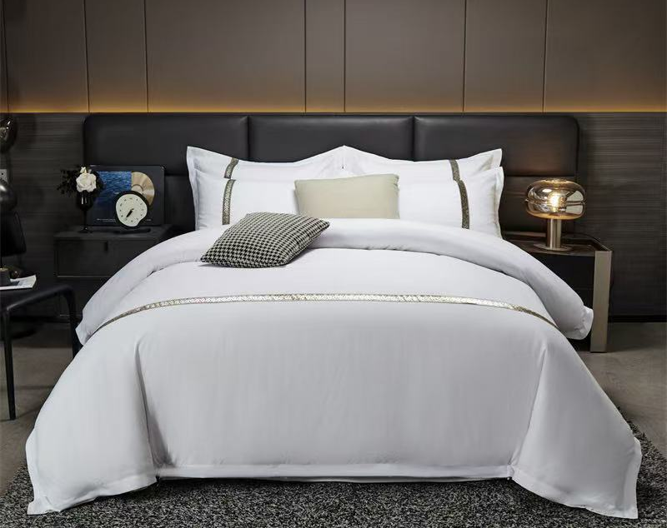
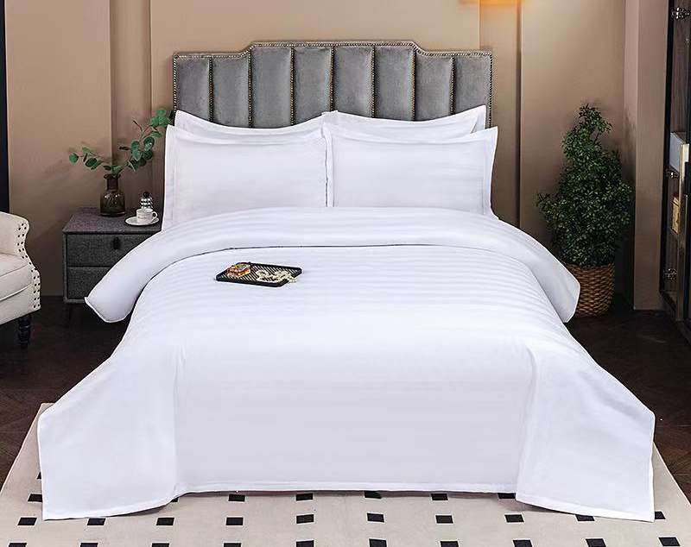
BEDDING COLLECTION
Decorative bedding styles 09-10
BL-09
Silver botanical trim
BL-10
Classic white stripe
White base. Trim and set configuration can be customized.
White base. Trim and set configuration can be customized.
CUSTOM HOTEL LINEN
08

Slide 9
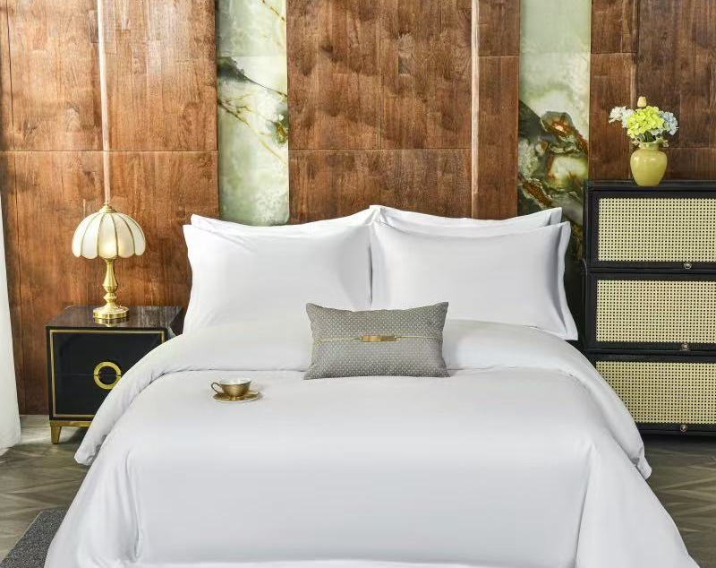
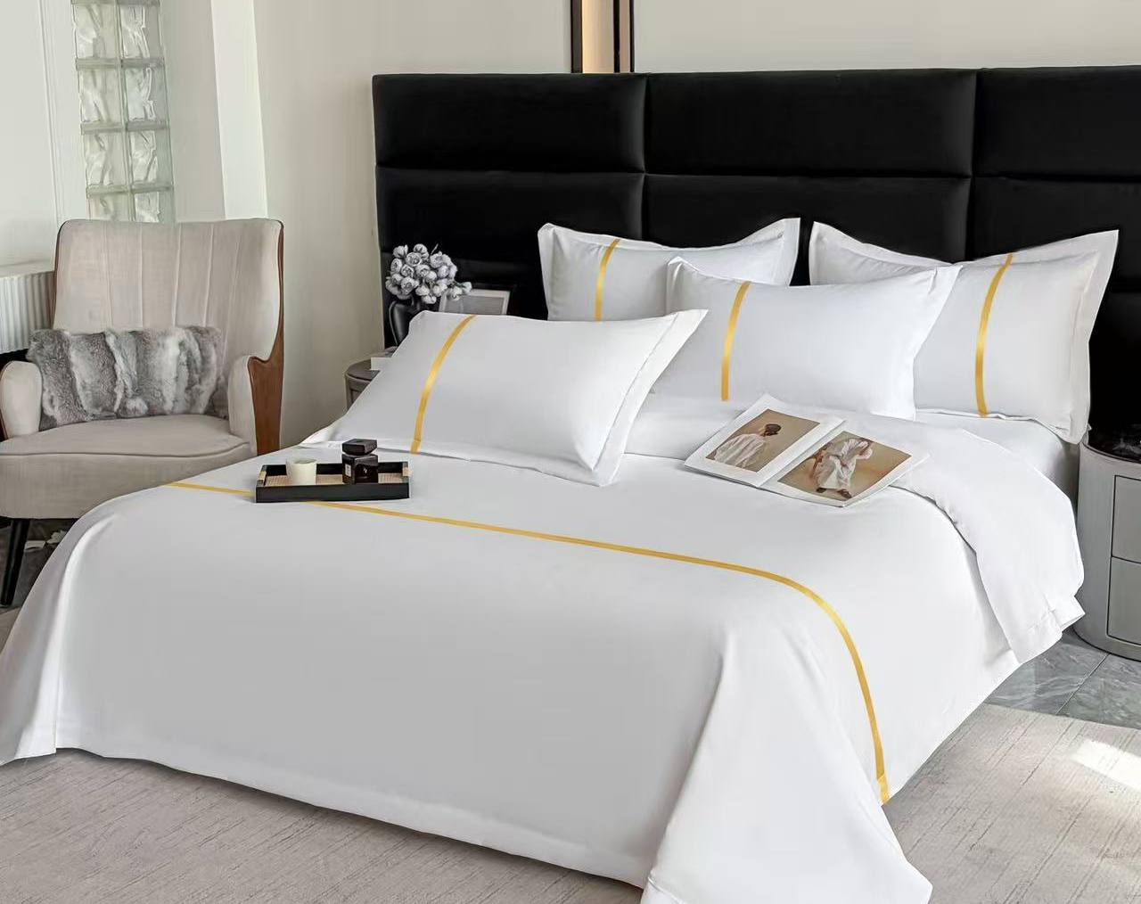
BEDDING COLLECTION
Decorative bedding styles 11-12
BL-11
Minimal white finish
BL-12
Gold piping
White base. Trim and set configuration can be customized.
White base. Trim and set configuration can be customized.
CUSTOM HOTEL LINEN
09

Slide 10
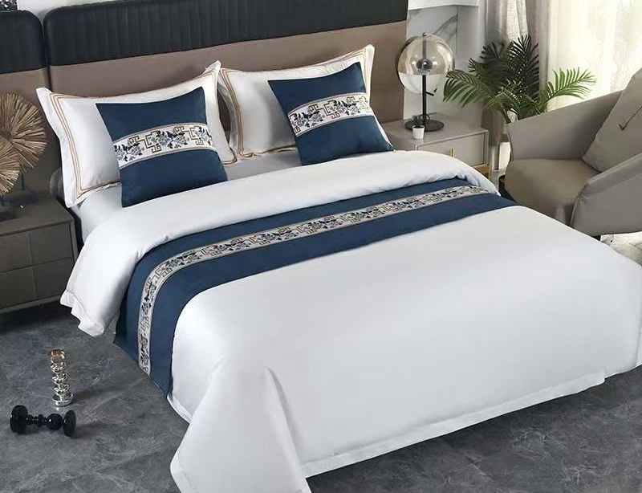
DECORATIVE ACCESSORIES
Bed runners and coordinated cushions
Reference sizes
1.2 m bed
Runner 50 × 180 cm
1.5 m bed
Runner 50 × 210 cm
1.8 m bed
Runner 50 × 240 cm
Cushion cover
50 × 50 cm
Cushion with insert
50 × 50 cm
Decorative tape, embroidery, dimensions and fabric weight are customizable.
CUSTOM HOTEL LINEN
10

Slide 11
BEDDING SPECIFICATIONS
Reference bedding configurations
Example construction: 120 GSM brushed cotton embroidered set
Bed width | Format | Duvet cover | Sheet | Pillowcase
1.2 m | Flat sheet | 150 × 200 | 180 × 240 | 55 × 85 (1)
1.5-1.8 m | Flat sheet | 200 × 230 | 240 × 250 | 55 × 85 (2)
2.0 m | Flat sheet | 220 × 240 | 240 × 270 | 55 × 85 (2)
1.2 m | Fitted sheet | 150 × 200 | 120 × 200 | 55 × 85 (1)
1.5 m | Fitted sheet | 200 × 230 | 150 × 200 | 55 × 85 (2)
1.8 m | Fitted sheet | 200 × 230 | 180 × 200 | 55 × 85 (2)
1.8 m | Fitted sheet, larger duvet | 220 × 240 | 180 × 200 | 55 × 85 (2)
2.0 m | Fitted sheet | 220 × 240 | 200 × 220 | 55 × 85 (2)
Dimensions in cm. Sizes, component count, fabric and weight can be customized.
CUSTOM HOTEL LINEN
11

Slide 12
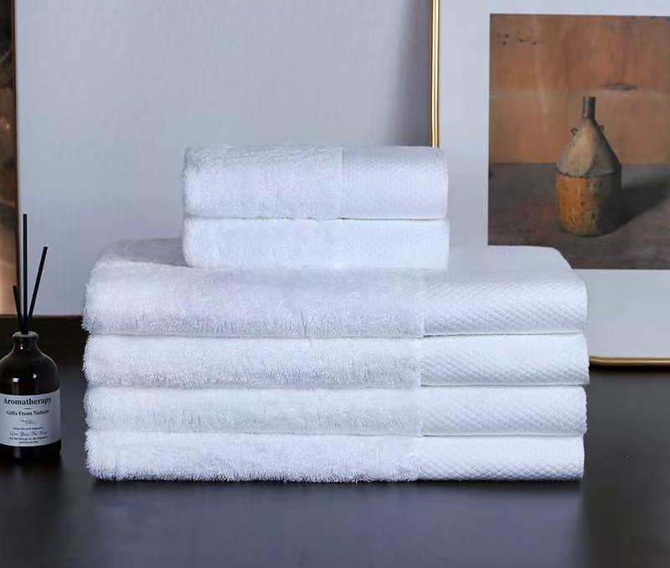
BATH LINEN
16S hotel towel series
Material and finish
100% cotton
White
Spiral pile with decorative dobby band
Type | Reference size
Face towel | 32 × 32 cm
Hand towel | 35 × 75 cm
Bath towel | 70 × 140 cm
Large bath towel | 80 × 160 cm
Custom size, GSM and embroidered logo available. Reference processing time: 3-5 days.
CUSTOM HOTEL LINEN
12

Slide 13
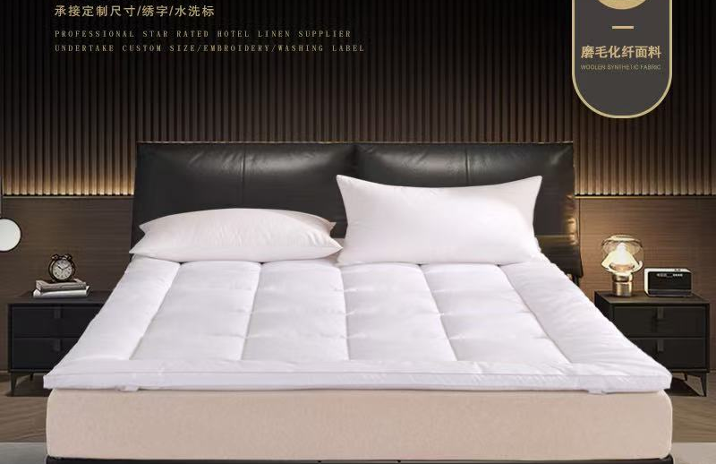
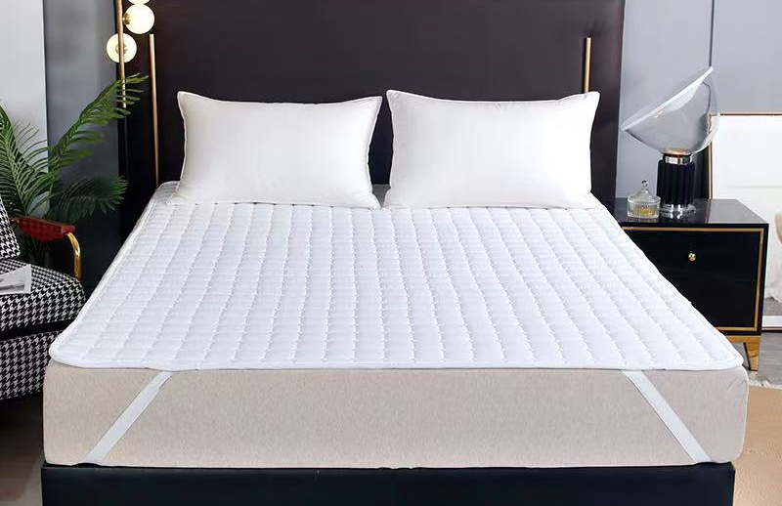
GUEST ROOM PROTECTION
Mattress protection options
Quilted fitted protector
Stain protection pad
Polyester shell and filling. Quilted finish. White.
Polyester shell and filling. Reference filling: 200 GSM.
Reference sizes: 90 × 200, 120 × 200, 135 × 200, 150 × 200, 180 × 200, 200 × 200, 200 × 220 cm
Reference sizes: 120 × 200, 150 × 200, 180 × 200, 200 × 220 cm
CUSTOM HOTEL LINEN
13

Slide 14
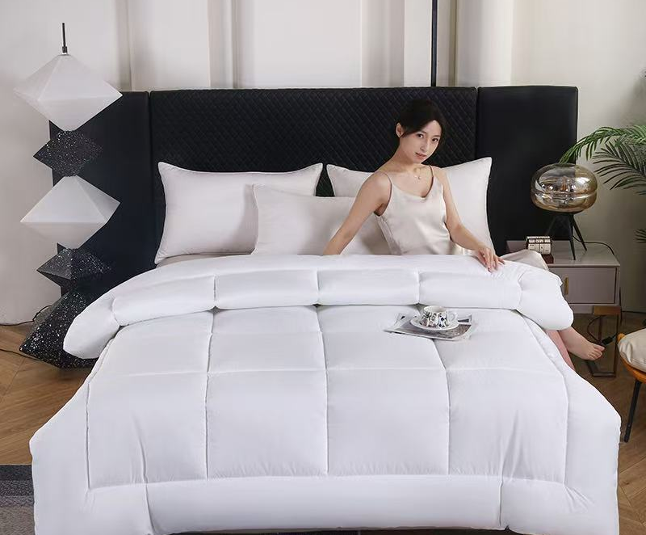
BEDDING INSERTS
Brushed microfiber quilt insert
Construction
Shell | Polyester fiber
Filling | Polyester fiber
Finish | Quilted, box stitching
Grade | Qualified product
Reference sizes
150 × 200 cm
160 × 220 cm
190 × 220 cm
200 × 230 cm
220 × 220 cm
220 × 240 cm
Custom dimensions and filling weight available.
CUSTOM HOTEL LINEN
14

Slide 15
PRODUCT INFORMATION
Reference standards and care
Standards shown in the supplied product information
Product group | Reference standard / instruction
Towels | GB/T 22843-2009; GB 18401-2010 Category C
Mattress protectors | GB/T 22843-2009; GB 18401-2010 Category C
Quilt insert | GB/T 22843-2009; GB 18401-2010 Category C
Quilt insert care | Wash at 30°C; do not bleach; low-temperature ironing; professional cleaning permitted
Please confirm final test requirements, labeling and destination-market compliance before production.
The listed standards and care instructions are reproduced from the supplied product data.
CUSTOM HOTEL LINEN
15

Slide 16
REQUEST A CUSTOM QUOTATION
Information for your inquiry
Share the details below so the product specification can be confirmed clearly.
STYLE
SIZE
Catalog code or reference photo
Bed size and finished product dimensions
FORMAT
WEIGHT
Flat sheet or fitted sheet; required set components
Requested GSM or filling weight
BRANDING
QUANTITY
Logo file and embroidery placement, if required
Quantity per item and delivery destination
Sizes, specifications and weights can be customized across the collection.
CUSTOM HOTEL LINEN
16

